Slide 1


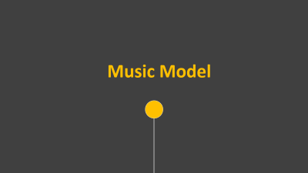
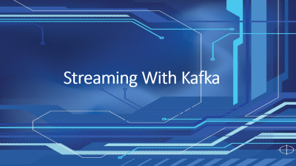
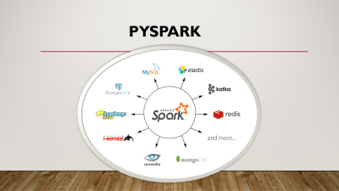
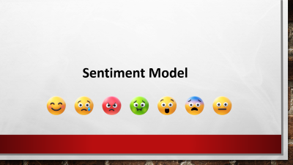



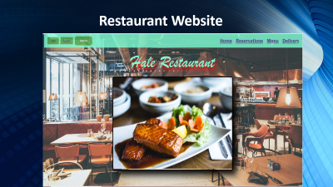

Senior Project
Introduction

Slide 2


Senior Project
Sentiment Model

Slide 3

Senior Project
Age/Gender Model

Slide 4
Senior Project
Music Model

Slide 5
Senior Project
Kafka

Slide 6
Senior Project
Spark

Slide 7
Senior Project
Website

Slide 8
Senior Project
Conclusion

Slide 9

Dynamic AI for ultimate customer satisfaction
By:
Hasan Akil
& Ali Issa Approved by:
Supervisor Dr.Linda Mahmoudi
Submitted to the Data Science Department
of the Lebanese University
Beirut, Lebanon
In partial fulfilment of the requirements for the degree of
BACHELOR OF DATA SCIENCE
2023-2024

Slide 10
Introduction
The project aims to enhance restaurant operations and customer satisfaction using advanced technologies like AI and real-time data processing.
The main focus is on implementing a facial recognition system to predict customer sentiment, age, and gender. This allows the restaurant to tailor services and the environment to better meet customer needs.

Slide 11

Tools Used In Project
1. Python
2. TensorFlow
3. Pandas
4. NumPy
5. Matplotlib
6. OpenCV (cv2)
7. Confluent Kafka
8. PySpark
9. Joblib
10. JSON (JavaScript Object Notation)
11. PIL (Python Imaging Library)
12. Keras
13. time
14. os
15. Kafka
16. requests
17. threading
18. logging
19. PHP
20. HTML (HyperText Markup Language)
21. CSS (Cascading Style Sheets)
22. JavaScript
22.Convolutional Neural Network (CNN)
23. Descison Tree Classifier

Slide 12







Sentiment Model

Slide 13










Sentiment Model
Implementaion
We implemented several key libraries in our project. We will briefly talk about some of them:
os
cv2
numpy
Tensorflow
Matplotlib
keras

Slide 14

Sentiment Model
Preparing Data
We organized our dataset into three main folders: training, validation, and testing. Each folder has subfolders for different classes happy,sad,angry,etc..
Paths:Using TensorFlow’s function image_dataset_from_directory:
We set paths for training, validation, and testing data.
Images were shuffled, resized to 48x48 pixels, batched in groups of 64, converted to grayscale, and labeled automatically.

Slide 15
Sentiment Model
Model Training
We built our sequential model by including several layers:
Conv2D
MaxPooling
Dropout
Flatten
Dense
Using Adam optimizer and monitoring accuracy
Our model was trained on 28,709 images for 50 epochs.

Slide 16
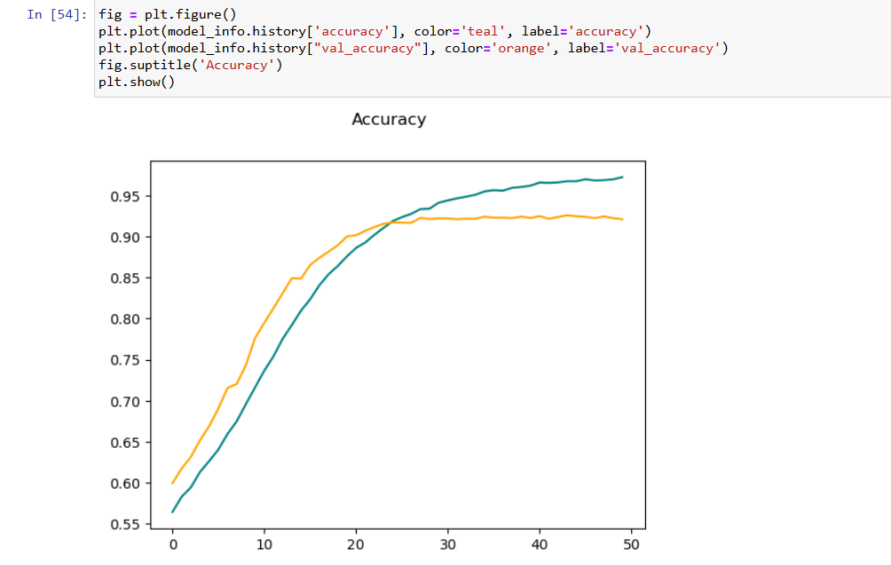
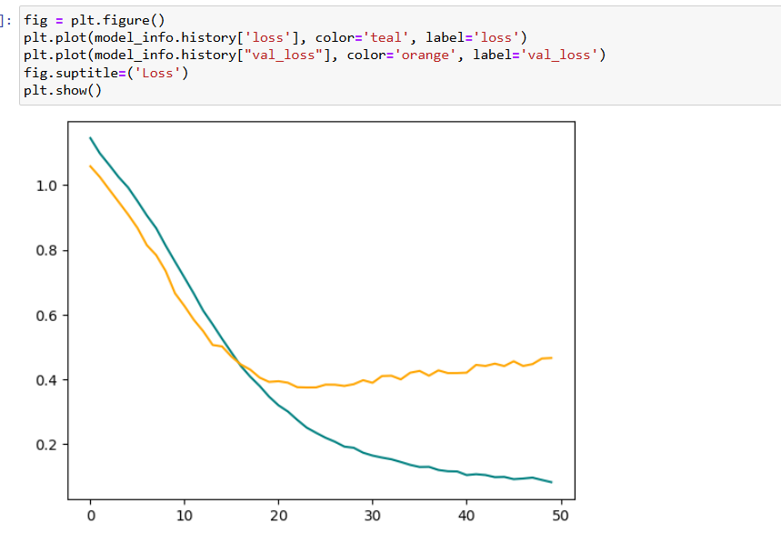
Sentiment Model
Model Ploting & Saving
After training our CNN model, we evaluated its performance by plotting the loss and accuracy for both the training and validation datasets. We saved both the model architecture and its weights separately. This allows us to easily reload the trained model for predictions or further training later on.

Slide 17
Sentiment Model
Model Testing
Results:
Surprised: 76.65%
Neutral: 62.53%
Happy: 84.78% (highest accuracy)
Fearful: 39.84%
Disgusted: 50.45%
Angry: 53.75%
Sad: 44%
Loading the Model:
We loaded the model architecture and the weights .
Evaluating Performance:
We tested the model on each emotion category.
Each test image was resized to 48x48 pixels and normalized before being input into the model.

Slide 18




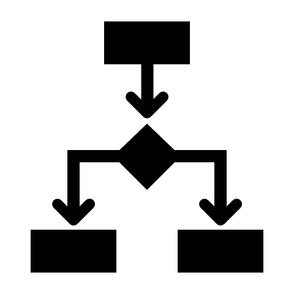


Age/Gender Model

Slide 19
We imported essential libraries and functions such as tensor flow and keras for model construction and training also :
os
warnings
numpy
pandas
Seaborn
Matplotlib
PIL
Tensorflow
Keras
Implementing libraries
Age/Gender Model

Slide 20
Base Directory Definition: BASE_DIR = r'C:\AgeDataset\UTKFace’
Lists Creation: Created empty lists to store image paths, age labels, and gender labels.
DataFrame Construction:
Constructed a Pandas DataFrame (df) with columns 'image', 'age', and 'gender' to organize structured data.
Checked data using df.head() to preview the first few rows.
Gender Mapping: Defined gender_dict to map integer gender values (0 and 1) to readable strings ('Male' and 'Female').
Defining Path

Slide 21
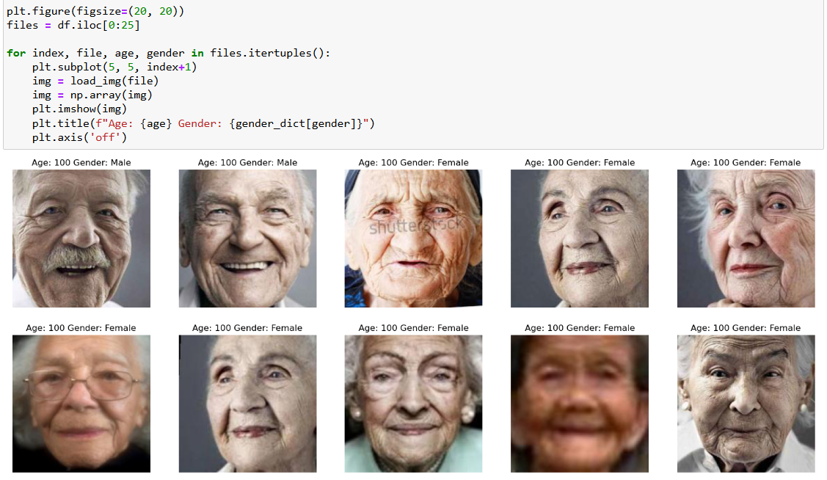
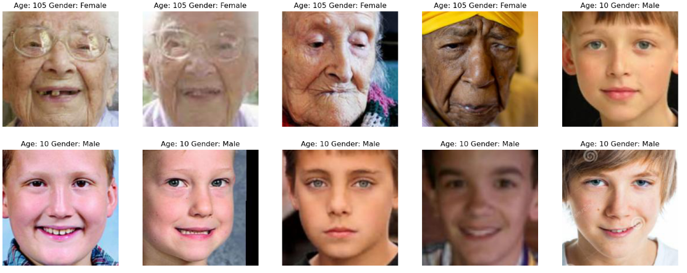
Data Visualization

Slide 22
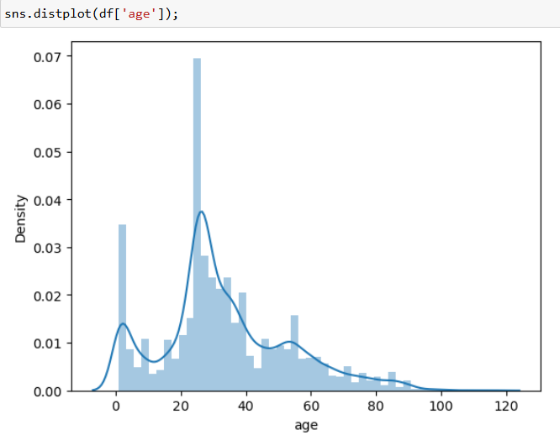
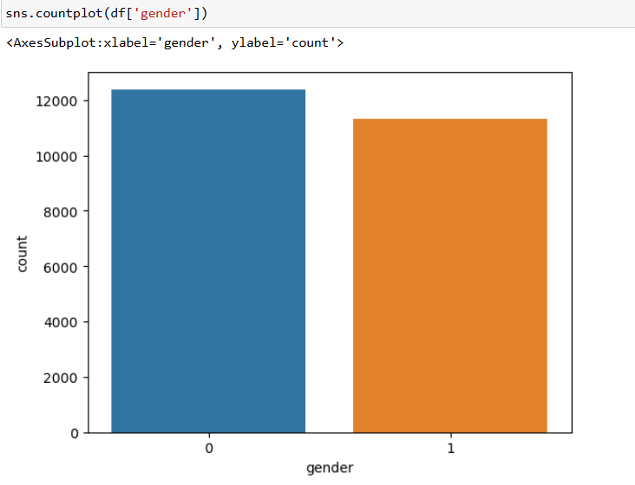
Data Visualization

Slide 23
Iteration: Iterates over each image path, loads images in grayscale using Keras' load_img, resizes to 128x128 pixels.
Conversion: Converts resized images to NumPy arrays.
Reshape: Reshapes the array to include a single channel dimension (number_of_images, 128, 128, 1).
Normalization: Normalizes pixel values by dividing by 255.0, scaling them between 0 and 1.
Label Extraction: Extracts gender and age labels from the DataFrame, converting them to NumPy arrays
Data Preprocessing

Slide 24
Model Architecture:
Simliar to sentiment model .This model contained combination of different layers Conv2D,MaxPooling,Dropout,Flatten ,Dense
Output Layers:
Two branches:
output_1: Predicts gender using sigmoid activation for probability scores (0 to 1).
output_2: Predicts age using ReLU activation for non-negative values.
Model Compilation:
Creates a Keras Model instance with inputs and outputs from both branches.
Compiles the model with:
binary_crossentropy for gender prediction.
mean_absolute_error for age prediction.
Uses Adam optimizer and monitors accuracy during training.
Model Training

Slide 25
We saved both the model architecture and its weights separately. This allows us to easily reload the trained model for predictions or further training later on.
Model Saving

Slide 26
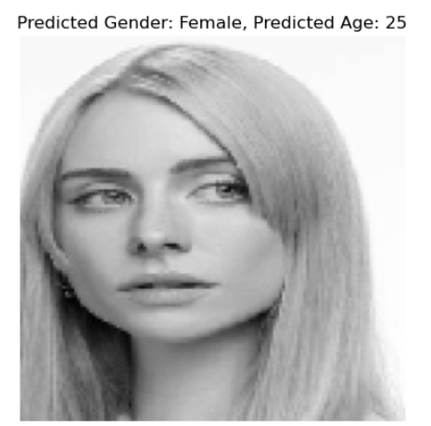
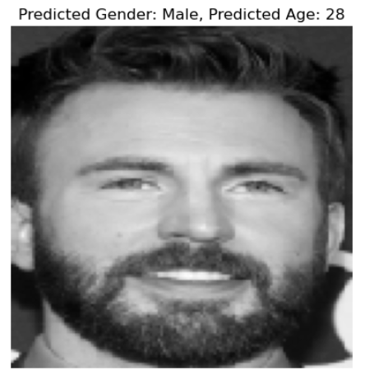
Model Testing

Slide 27
Music Model

Slide 28
Implementing libraries
We implemented several key libraries in our project. We will briefly talk about some of them:
joblib
numpy
pandas
LabelEncoder
DecisionTreeClassifier
train_test_split

Slide 29
Loading Dataset
We loaded our music dataset into a pandas DataFrame:
Defined the file path to "music3.csv" located on the Desktop.
Used pd.read_csv to read the file .
displaying the first five rows with df.head(), giving us an initial overview of the dataset.

Slide 30
Encoding Variables
We prepared our data for modeling:
Encoded Categorical Variables: Used pd.get_dummies to create binary columns
Merged Columns: Used pd.concat to combine these new columns with the original DataFrame.
Dropped Original Column: Removed the original 'Gender' column using df.drop(inplace=True).

Slide 31
Model Training
Splitting Data: Used train_test_split from sklearn.model_selection to allocate 5% of the data for testing (and shuffled the data (shuffle=True).
Decision Tree Classifier: Created clf_entropy using DecisionTreeClassifier with:
criterion="entropy"
max_depth=10
min_samples_leaf=3
Training the Model: Trained clf_entropy on the training data (X_train, Y_train) using fit

Slide 32
Model Saving
Using joblib.dump, we save clf_entropy in a binary format. This file allows easy sharing, or deployment for making predictions without retraining.

Slide 33

Streaming With Kafka

Slide 34

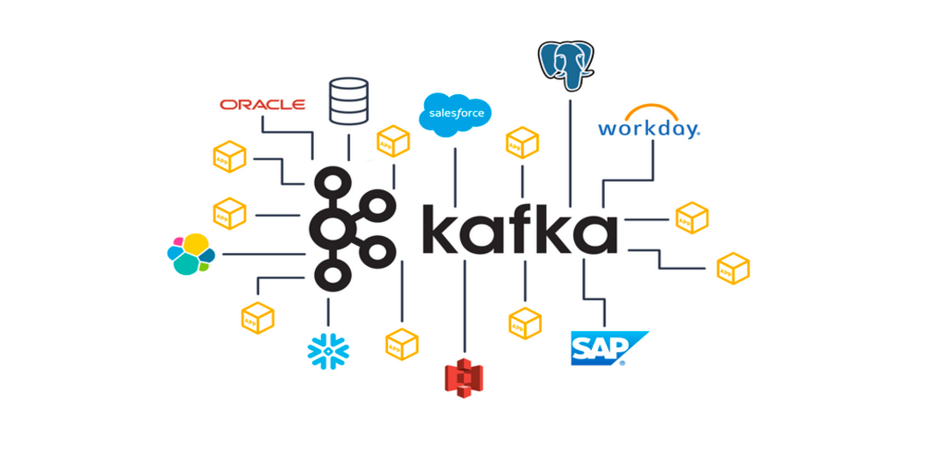
We import Confluent Kafka in addition to other libraries to help us connect our models to kafka .Confluent Kafka is a version of Apache Kafka with extra features. It makes it easier to set up, manage, and monitor data streaming.

Slide 35
Running Zookeeper ➔ .\bin\windows\zookeeper-server-start.bat .\config\zookeeper.properties
Running kafka Sever ➔ .\bin\windows\kafka-server-start.bat .\config\server.properties
Create Topic name “face”➔ .\ C:\kafka_2.13-3.7.0\bin\windows>kafka-topics.bat --create --bootstrap-server localhost:9092 --topic face
Running kafka producer ➔ C:\kafka_2.13-3.7.0\bin\windows> kafka-console-producer.bat --broker-list localhost:9092 --topic face
Running kafka consumer ➔ C:\kafka_2.13-3.7.0\bin\windows
kafka-console-consumer.bat --topic face --bootstrap-server localhost:9092 --from-beginning
Notes:
Zookeeper: Manages and coordinates Kafka servers. It keeps track of the status of Kafka nodes and topics, handles leader election for Kafka partitions, and maintains configuration information.
Kafka Server: Handles the actual storage and processing of messages. It manages the data streams, allowing producers to send data and consumers to read data from Kafka topics.

Slide 36
We loaded our 3 models Sentiment,Age/Gender,Music
Setup: Configured a Kafka producer and defined label mappings for emotions and gender.
Video Capture: Captured and resized video frames.
Face Detection: Detected faces in each frame and extracted face regions (ROIs).
Predictions: Used pre-trained models to predict gender, age, and emotion from the ROIs.
Music : Predicted music based on gender, age, and emotion.
Streaming: Sent predictions as JSON messages to the Kafka topic "face".

Slide 37
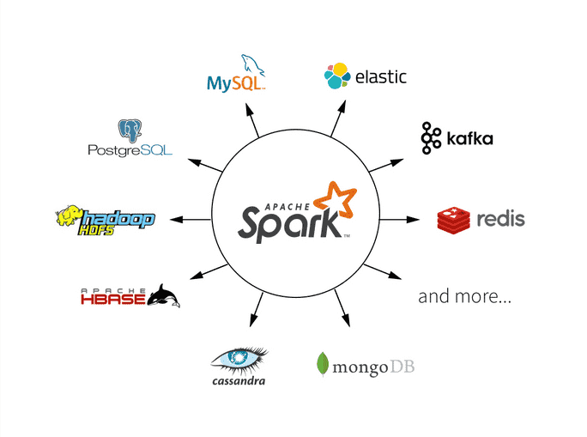
PYSpark

Slide 38
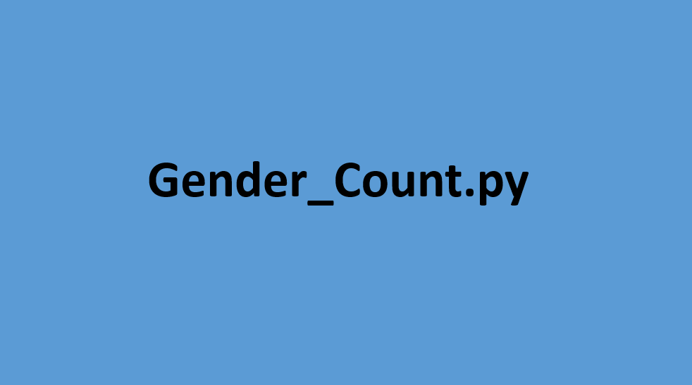

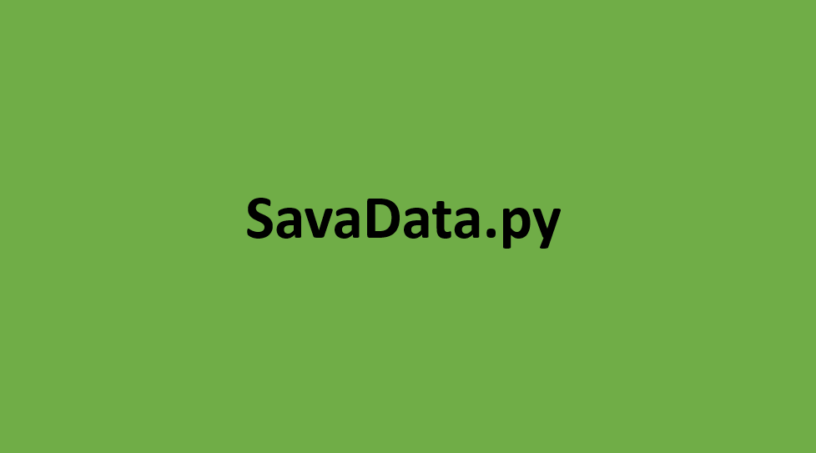
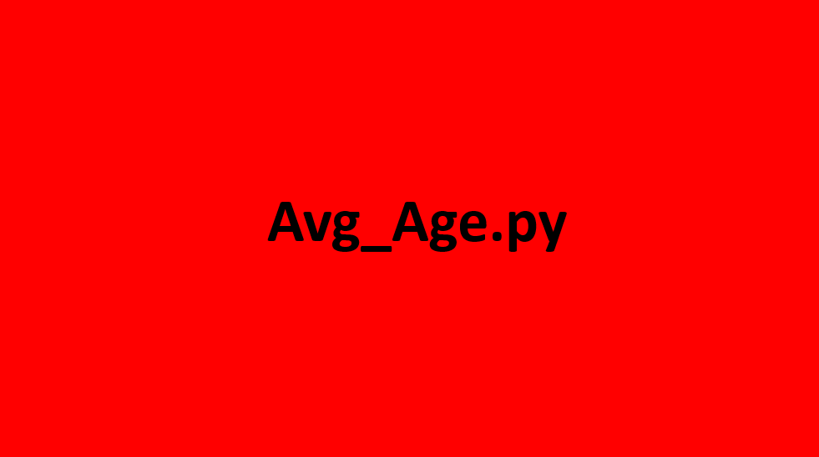

PYSPARK FILES

Slide 39
SaveData.py
We start by importing PySpark libraries. Next, we set up a Spark session configured to include the necessary Kafka packages. We then define a schema for the incoming Kafka messages. After that, we create a DataFrame by specifying the Kafka address and topic. Finally, we define the path where our output will be saved as JSON files.

Slide 40
others
We followed the same steps for implementing libraries, creating a Spark session, and connecting to Kafka. In gender_count.py we created a function that counts males and females and sends this data to the website for live streaming. Additionally, we ensured fault tolerance by defining a checkpoint file.
Same steps were applied for others

Slide 41

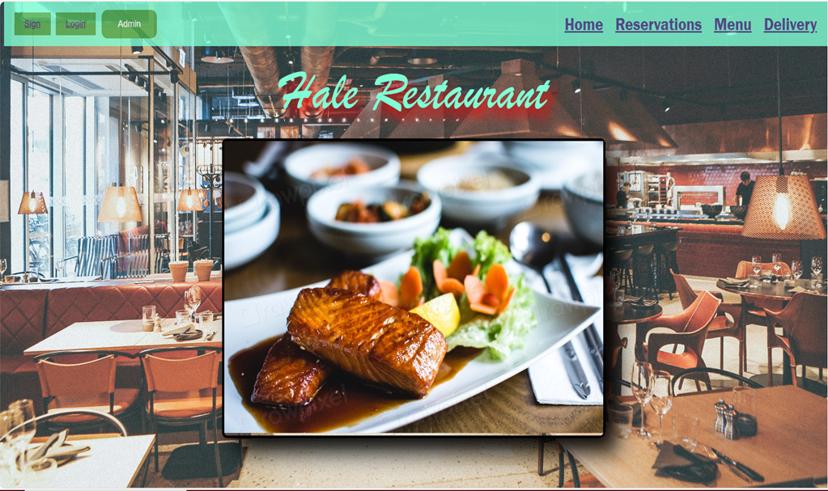
Restaurant Website

Slide 42








IIII
Home
Home Page
Sign Up
LogIn
Menu
Reservation
Delivery
Admin

Slide 43
IIII
Home
Home Page
Sign Up
LogIn
Navigation Bar: Links to site sections (homepage, reservations, menu, delivery) are structured for easy access and Buttons like "Logout", "Login", and "Admin" are shown based on session status
Slideshow of Restaurant Images
About Us Section: describing the restaurant.
Footer: Displays contact info (address, phone, email) and links to social media (Facebook, Twitter, Instagram)
Menu
Reservation
Delivery
Admin

Slide 44
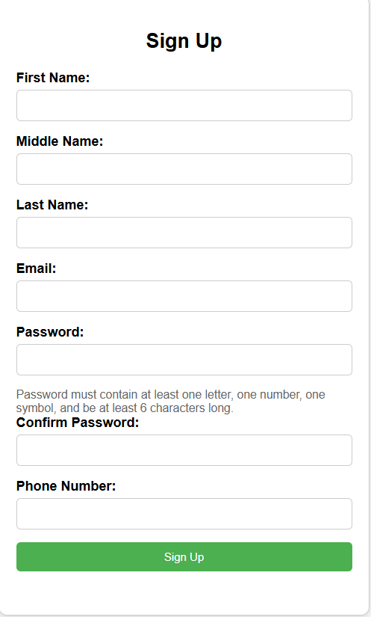
IIII
Home
Signup Page
Sign Up
LogIn
User Registration and Validation
Form Fields: Collects user details such as first name, middle name, last name, email, password, confirmed password, and phone number.
Password Requirements: Specifies password criteria (at least one letter, one number, one symbol, minimum length of six characters) with user instructions.
Submission: Validates form completion and sends data to "signin.php" for processing, ensuring a smooth registration process with error feedback.
Menu
Reservation
Delivery
Admin

Slide 45
IIII
Home
Signup Page
Sign Up
MySQL Database Connection and Input Validation
Input Validation Functions: Defines functions (isValidName, isValidPhoneNumber, isValidEmail) to validate user input
Data Sanitization: Uses real_escape_string to sanitize and prevent SQL injection for user inputs
Database Connection: defines database connection details (server name, username, password, database name), checks connection status, and handles errors.
LogIn
Menu
Reservation
Delivery
Admin

Slide 46
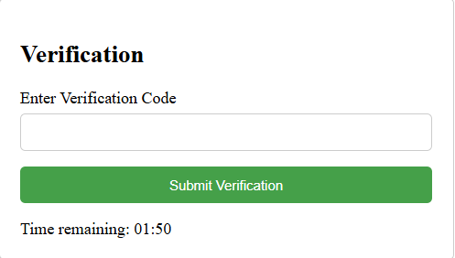
IIII
Home
Signup Page
Sign Up
LogIn
Menu
Upon submission a four digit verification code is sent to email using php mailer user needs to enter the code in 2 minutes
After user enter the code the password is hashed and the other information are all inserted in the database
Reservation
Delivery
Admin

Slide 47
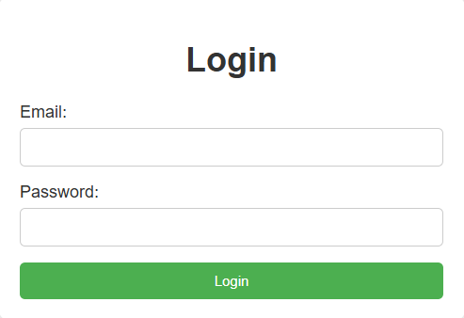
IIII
Home
LogIn Page
Sign Up
LogIn
Menu
Reservation
In Login page the user entered his email and password which are then santizied to prevent sql injecteion and compared with the database if correct the user is proceeded to home .Otherwise an error message is displayed
Delivery
Admin

Slide 48
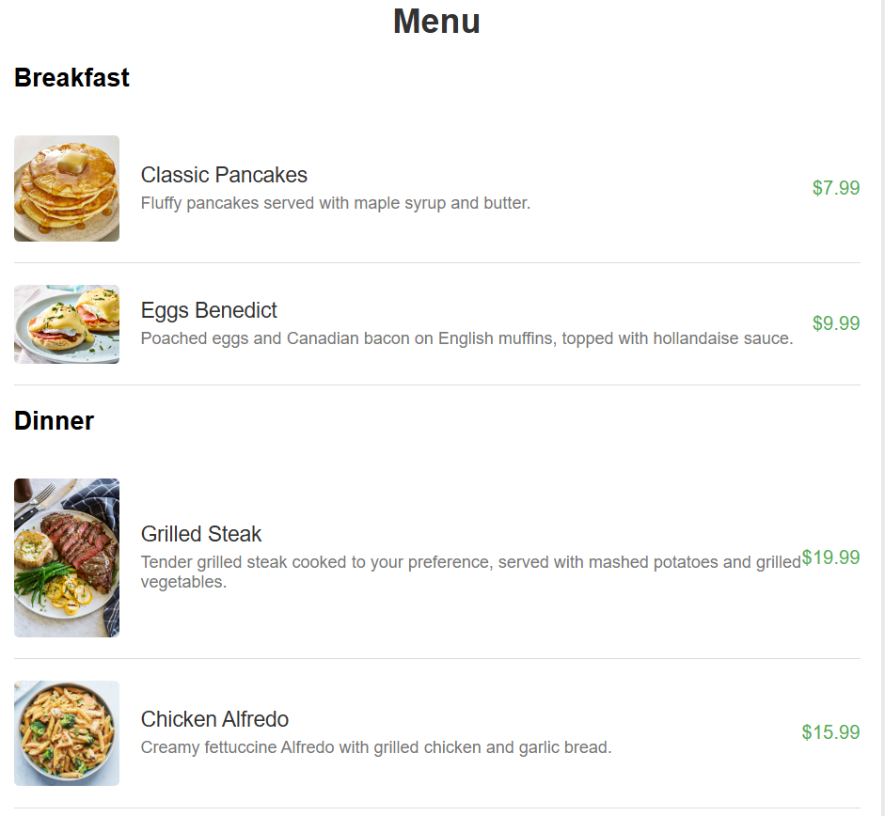
IIII
Home
Menu Page
Sign Up
The Menu Page include list of breakfast , dinner ,dessert, drinks
LogIn
Menu
Reservation
Delivery
Admin

Slide 49
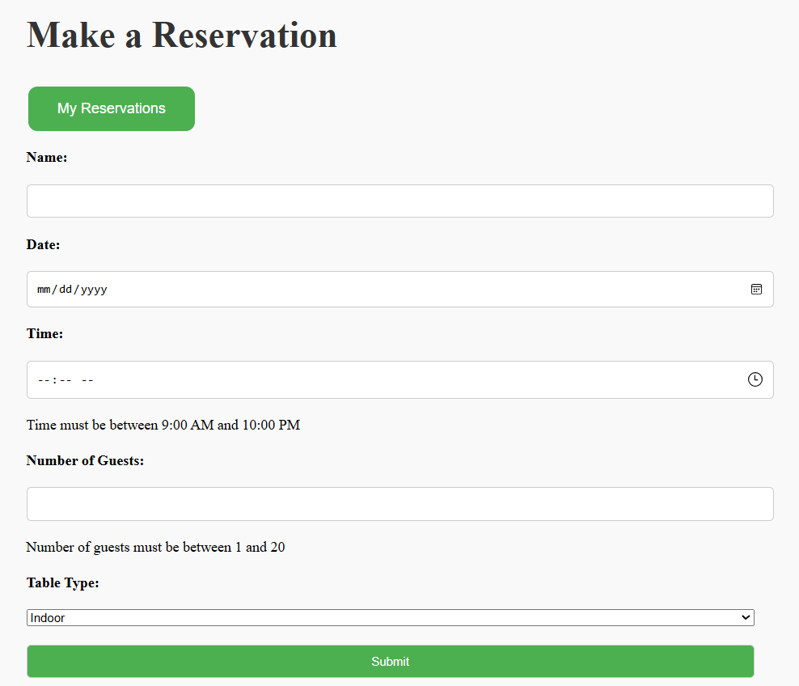
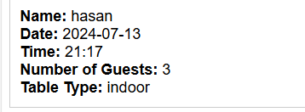
IIII
Home
Reservation Page
Sign Up
LogIn
The user need to be logged in to access the reservation page .Here he can book a reservation and choose table type . Additionally, users can view their upcoming reservations.
Menu
Reservation
Delivery
Admin

Slide 50
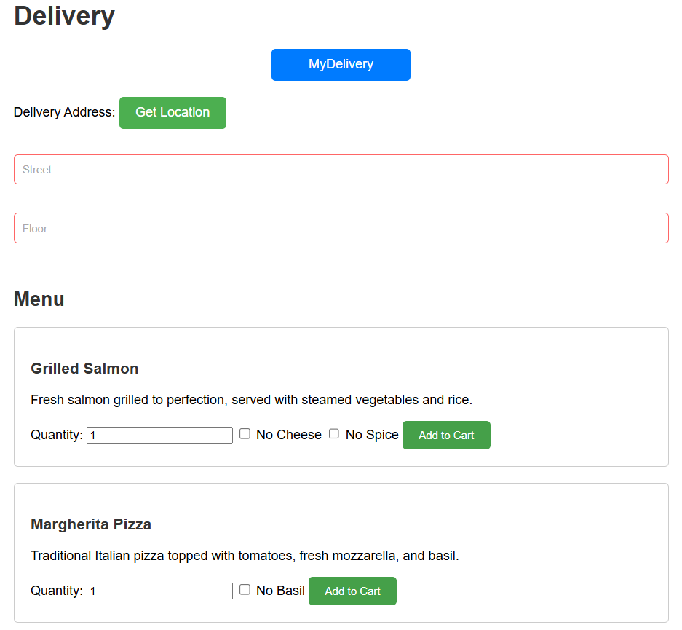
IIII
Home
Delivery Page
Sign Up
Similar to the reservation page The user need to be logged in to access the delivery page .The user can order deliveries after entering the required information and sharing his location.An estimated time of the order will show once he share his location . Additionally, users can view their upcoming deliveries.
LogIn
Menu
Reservation
Delivery
Admin

Slide 51
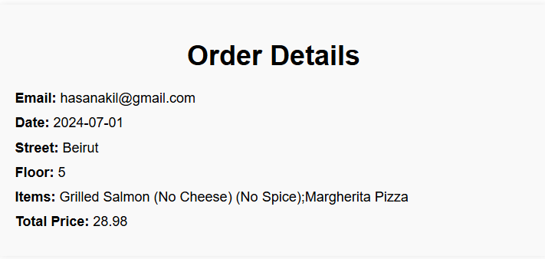
IIII
Home
Delivery Page
Sign Up
LogIn
Menu
Reservation
Delivery
Admin

Slide 52
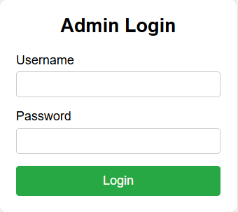
IIII
Home
Admin Page
Sign Up
LogIn
The Administrator Login Page is exclusively for authorized personnel. It requires an email and password, provided only to specific individuals. There is no option to sign up.
Menu
Reservation
Delivery
Admin

Slide 53
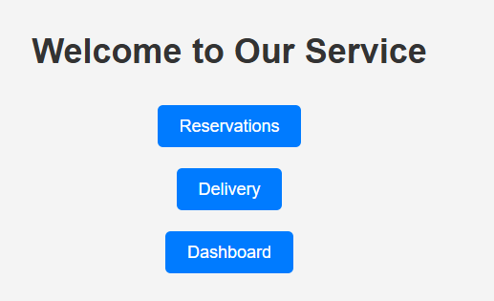
IIII
Home
Admin Page
Sign Up
LogIn
Menu
After logging in, the admin is given three options: access customer reservations, customer deliveries order, or customer data.
Reservation
Delivery
Admin

Slide 54
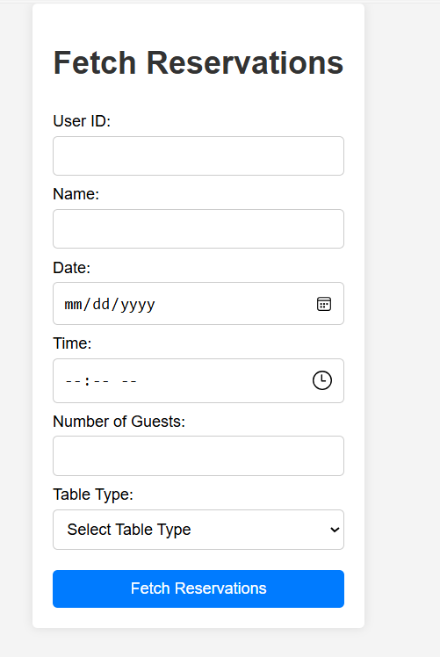
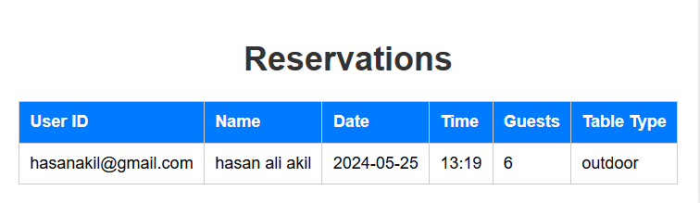
IIII
Home
Admin Page
Sign Up
LogIn
Menu
In this page the admin can get customer reservation based on some features
Reservation
Delivery
Admin

Slide 55
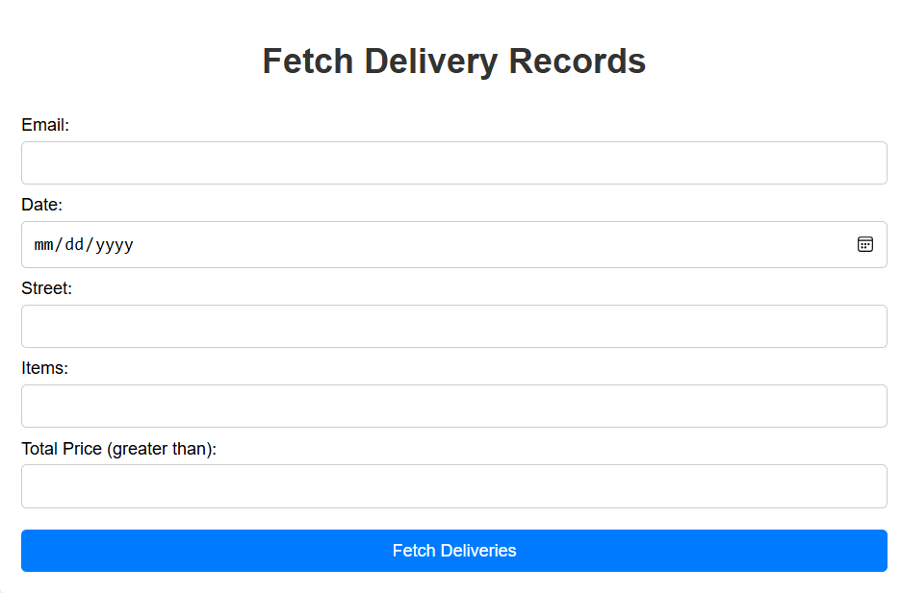
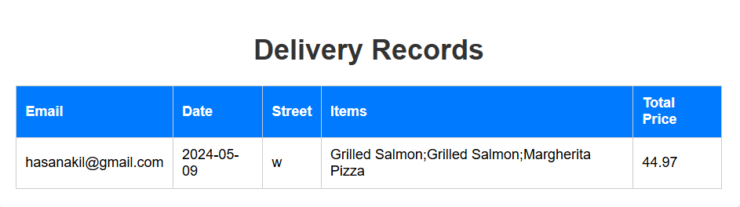
IIII
Home
Admin Page
Sign Up
Simliar to the reservation page the admin can get customer order based on some features
LogIn
Menu
Reservation
Delivery
Admin

Slide 56
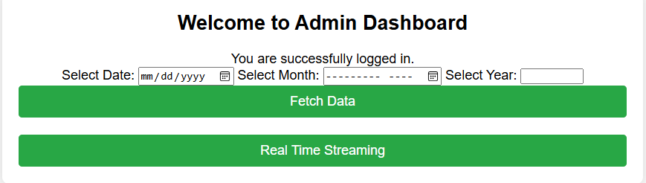
IIII
Home
Admin Page
Sign Up
LogIn
In the Admin dashboard, the admin can retrieve customer data based on a specific day, month, or year. The second option allows access to real-time customer data
Menu
Reservation
Delivery
Admin

Slide 57
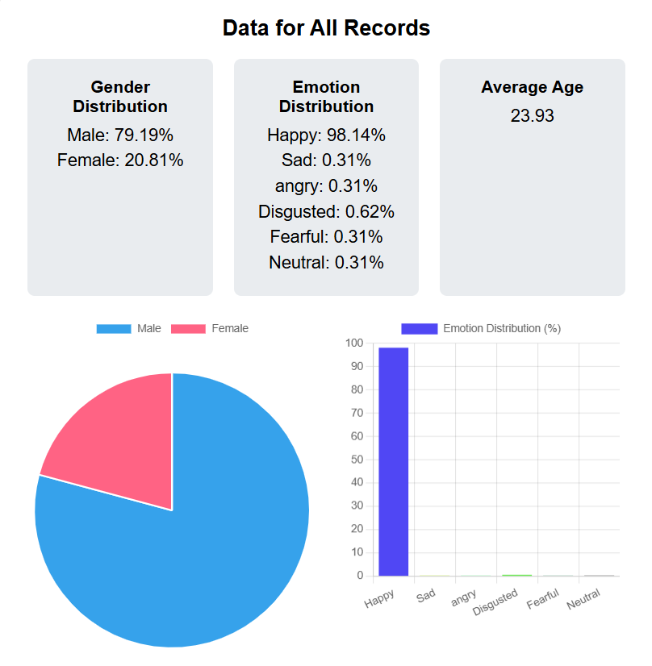
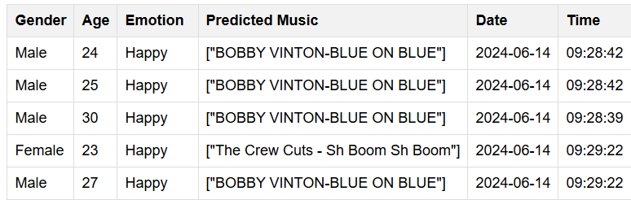
IIII
Home
Admin Page
Sign Up
LogIn
Menu
Reservation
Delivery
Admin

Slide 58
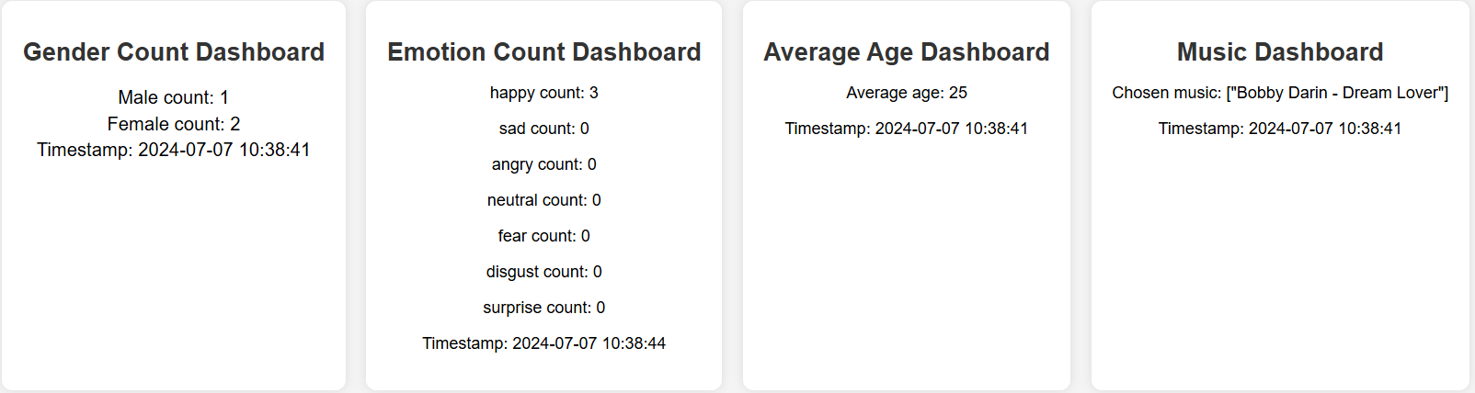
IIII
Home
Admin Page
Sign Up
LogIn
Menu
Reservation
Delivery
Admin

Slide 59


Slide 60
Problems Faced
In our project, we faced several challenges.
Ensuring the quality of data as it was hard finding data with great quality that affected our models accuracy.
Improving model accuracy required a lot of effort and changing the model consistently.
Working and setting up kafka and spark for the first time was very difficult.
Connecting all parts of the project—like the predictive models, streaming data, and the website—was complex and required a lot of effort to make everything work together smoothly

Slide 61
Conclusion
We combined deep learning and machine learning models in Python and TensorFlow with real-time data streaming through Kafka and Spark to provide instant insights. Our comprehensive website, built with PHP, HTML, CSS, and JavaScript, enhances customer interactions and supports restaurant managers with real-time analytics. This project highlights the importance of technology in meeting customer expectations and improving restaurant operations, setting a new standard for the industry.

Slide 62
New horizon
Looking ahead, we can improve the project in several ways:
Expand Predictive Models: Add models to predict more aspects of customer behavior, like dining preferences and likelihood of repeat visits.
Use Natural Language Processing (NLP): Enable the system to understand and respond to customer feedback in real-time for a more personalized experience.
Integrate IoT Devices: Gather detailed data on customer interactions with the environment, such as showing the number of free tables (indoor, outdoor, etc.) on the website.
Enhance Data Security: Strengthen privacy measures as the system handles more sensitive information.

Slide 63
Ending

